Slide 1
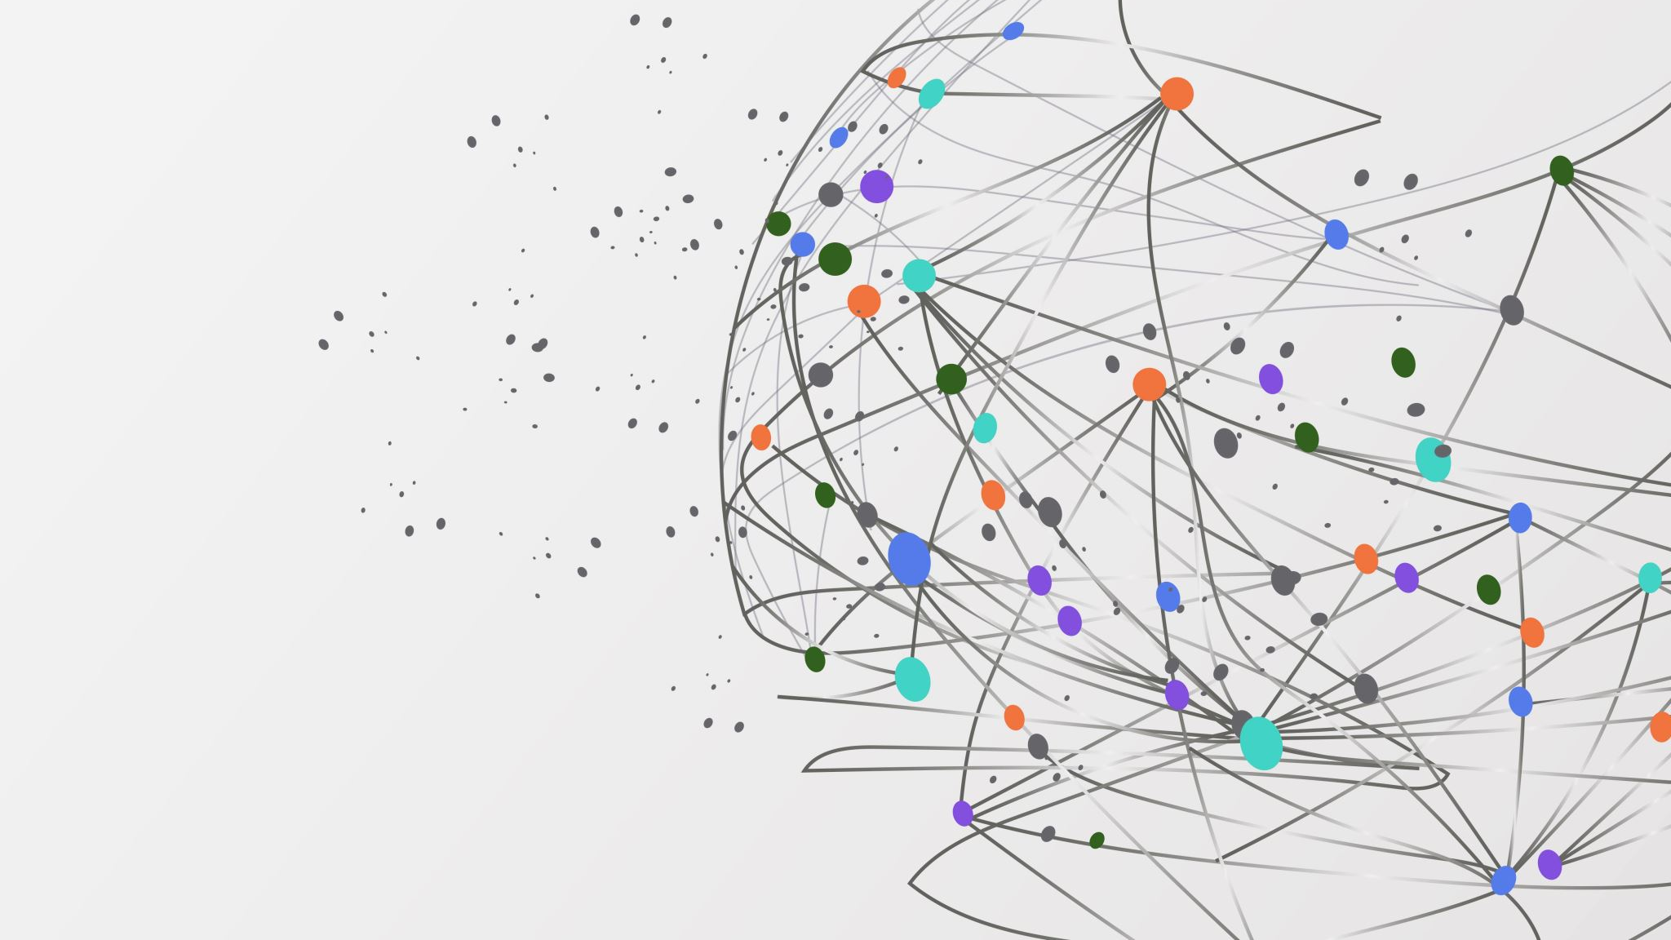
Beyond Eyes Highlights going beyond traditional sight.
~Submission for Build For Everyone With AI
~Subbmitted by: Anup Rijal

Slide 2
THE CHallenge
"285 million people worldwide are visually impaired." (Source: WHO)
Targeted Audience:
Blind and Visually Impaired Individuals: Struggle to understand visual scenes and objects.
People with Cognitive Disabilities: Need assistance simplifying and interpreting scenes.
Individuals with Learning Disabilities: Difficulty interpreting visual cues or text.
Elderly with Vision or Cognitive Decline: Require easy-to-use tools for vision loss or slower processing.

Slide 3
Presenting: BEYOND EYES
BEYOND EYES is a simple, accessible tool designed to empower visually impaired individuals by capturing and analyzing images in real-time and providing auditory feedback. Key Benefits:
Real-time image capture and analysis.
Integration with the Gemini API for precise scene descriptions.
Audio feedback for full accessibility.

Slide 4
Presenting: BEYOND EYES
BEYOND EYES is a simple, accessible tool designed to empower visually impaired individuals by capturing and analyzing images in real-time and providing auditory feedback. Key Benefits:
Real-time image capture and analysis.
Integration with the Gemini API for precise scene descriptions.
Audio feedback for full accessibility.

Slide 5
Key Features
Webcam-based image capture.
AI-powered image analysis using Gemini API.
Text-to-speech functionality for auditory descriptions.
Simple keyboard-based controls (C to capture, Q to quit).
Auto-quit after a single analysis for ease of use.

Slide 6
See the Solution in Action
Webcam-based image capture.
AI-powered image analysis using Gemini API.
Text-to-speech functionality for auditory descriptions.
Simple keyboard-based controls (C to capture, Q to quit).
Auto-quit after a single analysis for ease of use.

Slide 7
Impact
Empowerment: Promotes independence for visually impaired users.
Accessibility: Offers cost-effective, real-time assistance.
Scalability: Potential to integrate with smartphones or wearable devices for broader use.

Slide 8
Future Plans
Mobile app development for portability.
Multilingual support for wider accessibility.
Integration with OCR (Optical Character Recognition) to enable text reading.

Slide 9


